Slide 1

Bank Loan Case Study
Kovuru Venkata Chandana mythri

Slide 2
Overall approach of the analysis
Risk analytics is a field that involves using statistical techniques to identify and analyze the risk associated with a particular situation or decision. In the context of this case study, risk analytics can be used to analyze the risk associated with lending money to a particular client, based on their credit score, payment history, income level, and other relevant factors.
The primary objective of this case study is to identify patterns that indicate if a client has difficulty paying their loan installments, which can be used to take actions such as denying the loan, reducing the loan amount, lending to risky applicants at higher interest rates, etc. The aim is to ensure that consumers capable of repaying the loan are not rejected while identifying the factors that strongly influence loan default.

Slide 3
Outliers
SK_ID_PREV: A unique identifier for each previous loan application.
SK_ID_CURR: A unique identifier for each current loan application.

Slide 4
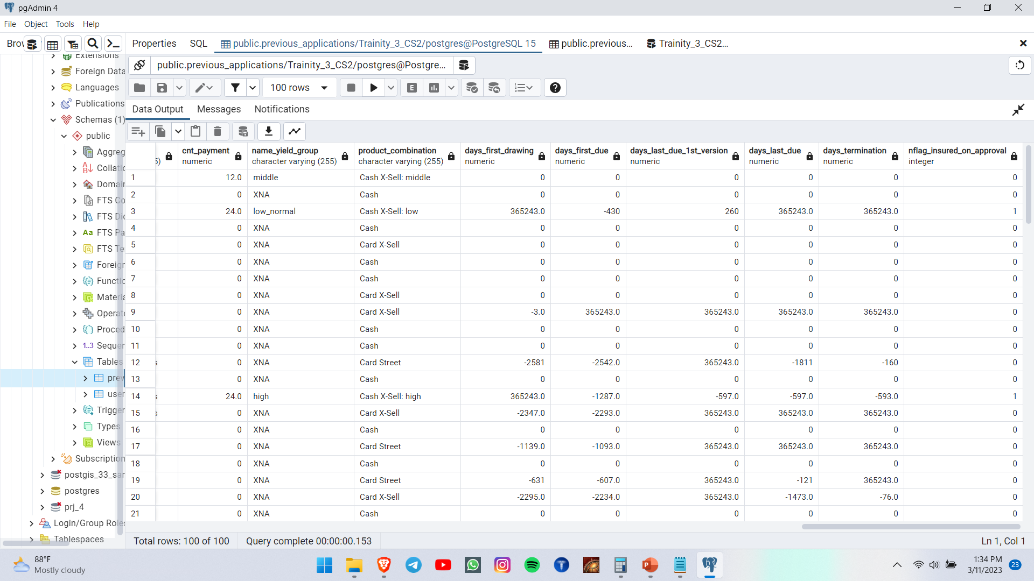
Clean Data

Slide 5
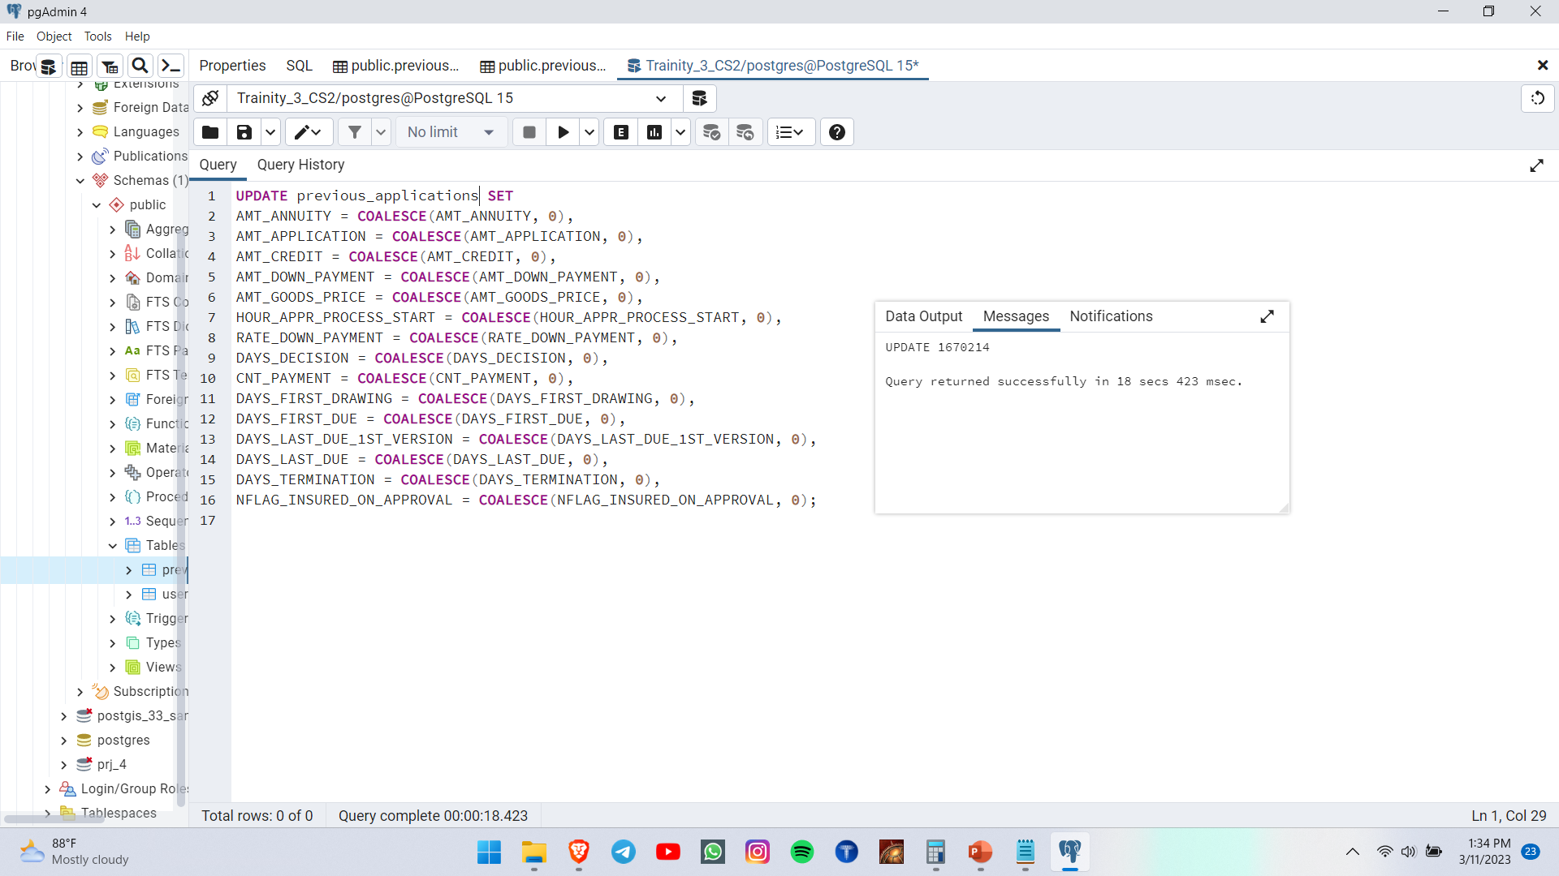
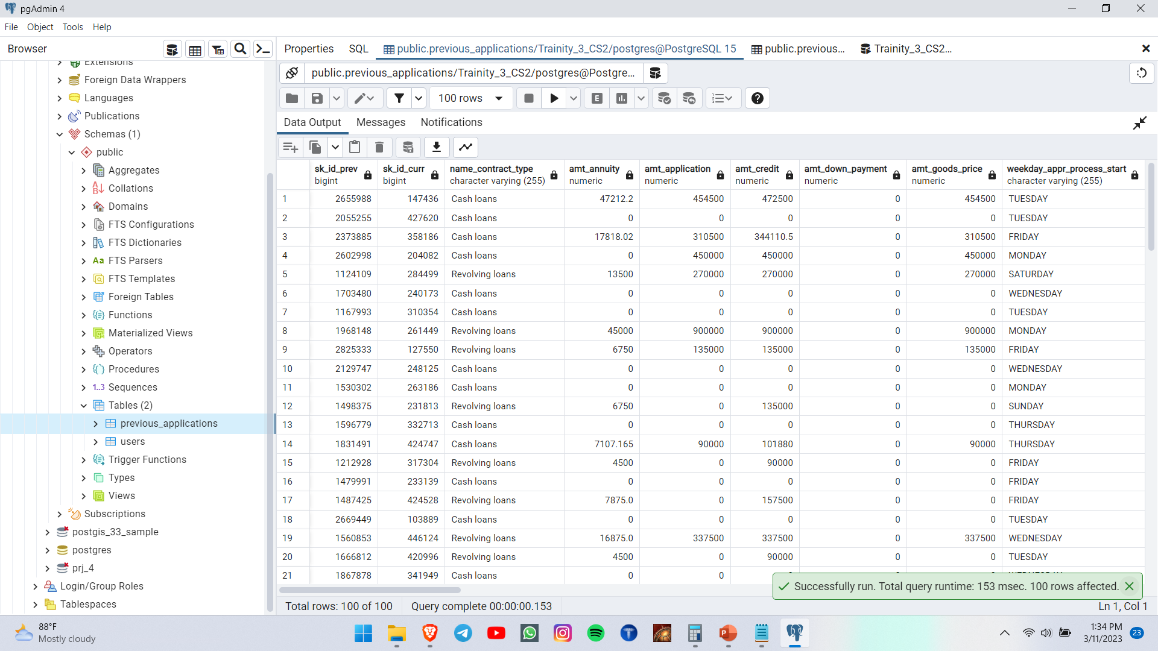
Null values cleared

Slide 6
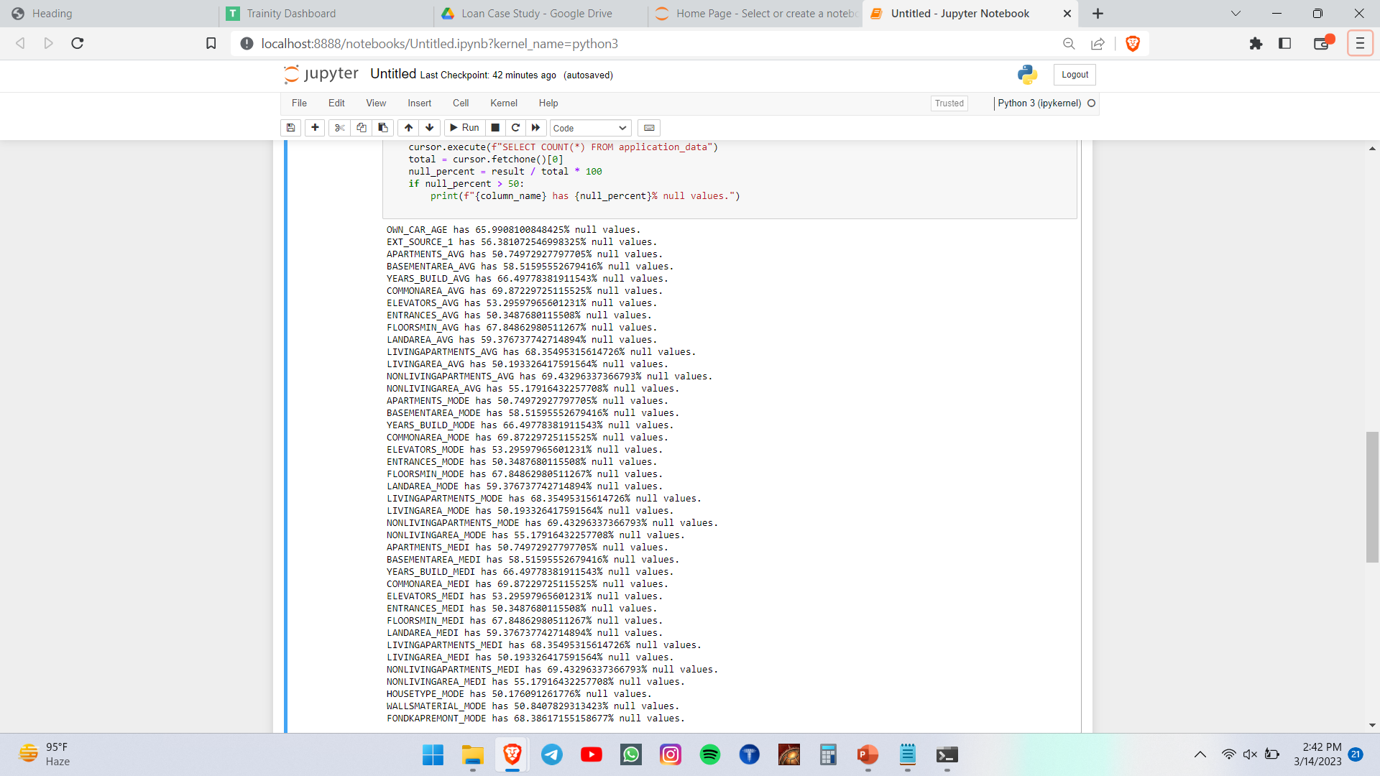
Cleaning the data

Slide 7
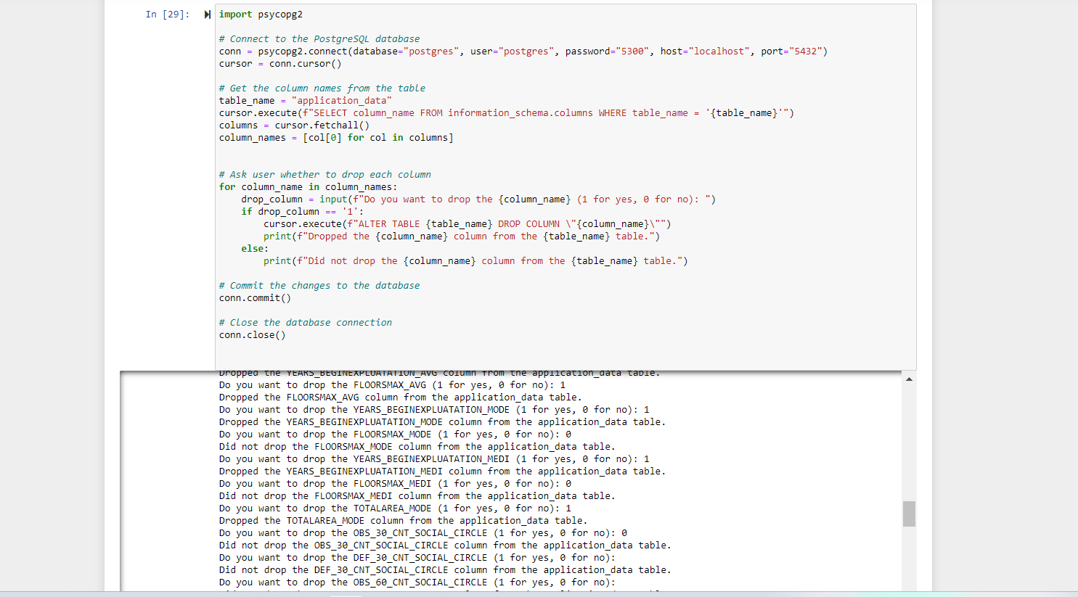
Columns dropped using the following code

Slide 8
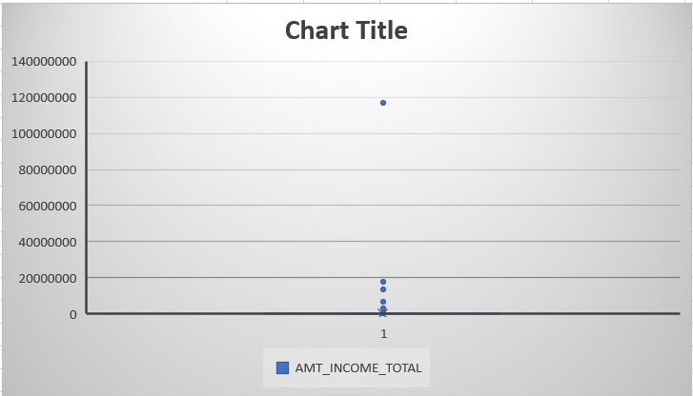
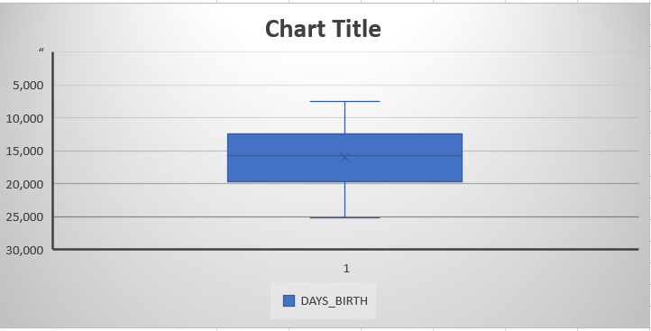
Outliers:-

Slide 9
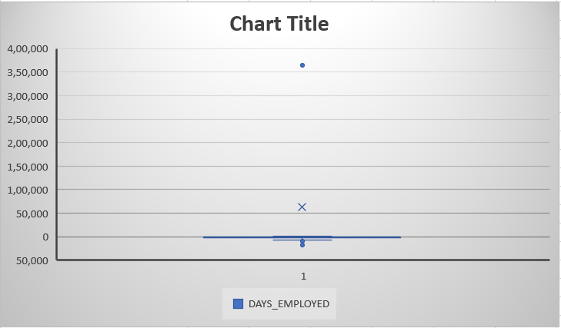
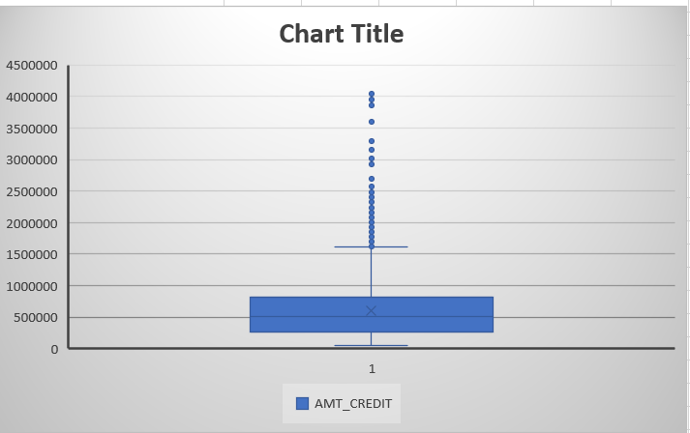
Outliers:-

Slide 10
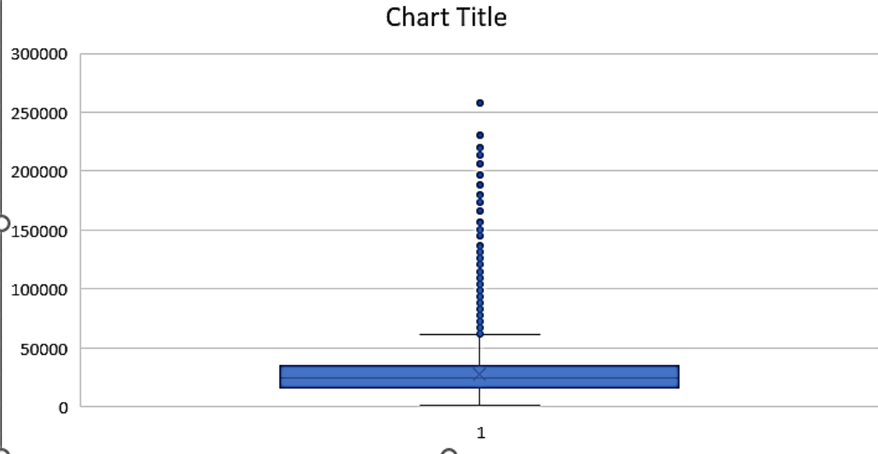
AMT_ANNUITY

Slide 11
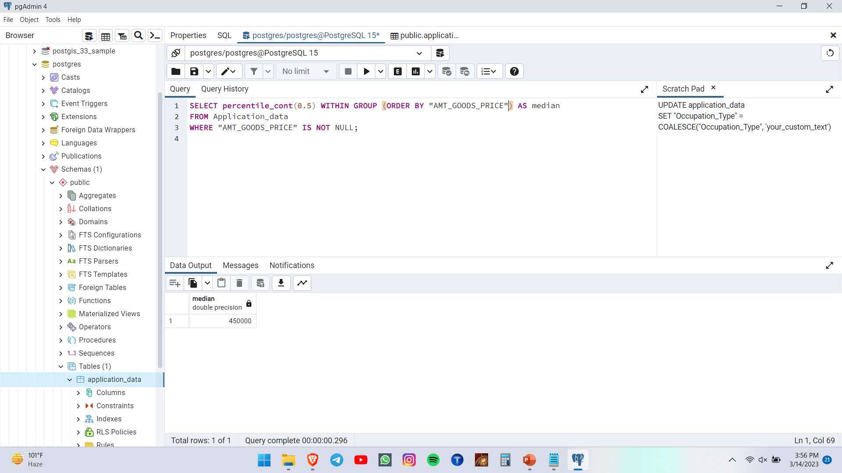
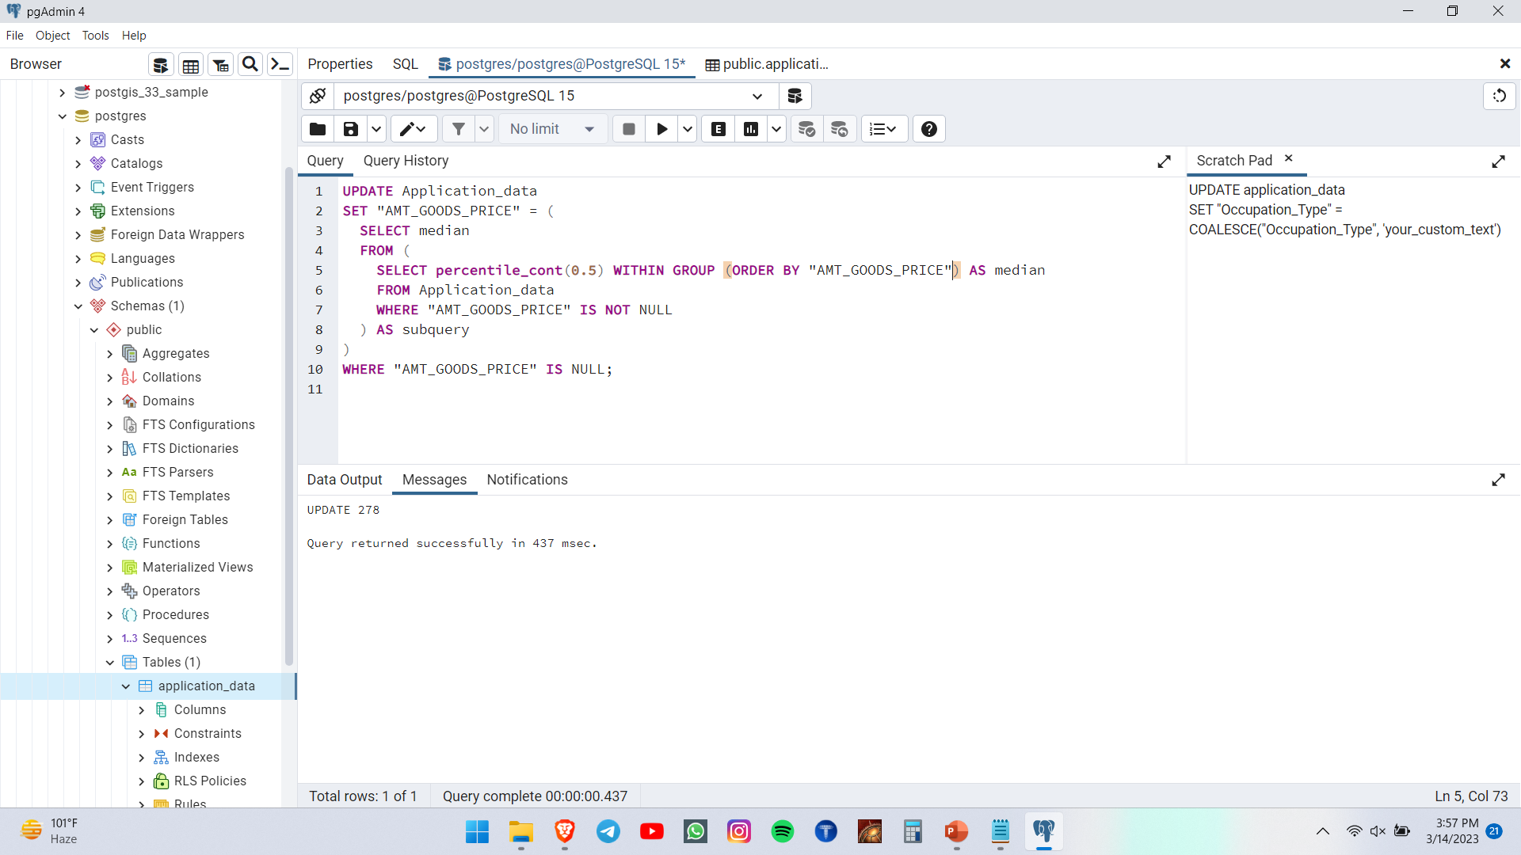
Filling null values with respective medians and appropriate values for example null value in occupation_type column is replaced with “unemployed” category and so on.

Slide 12
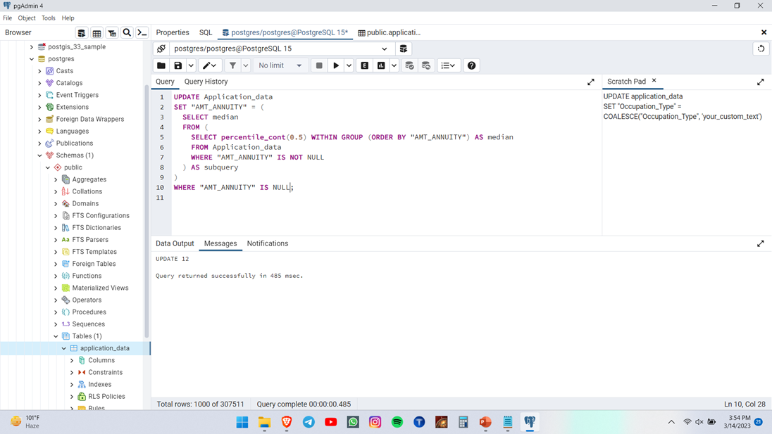
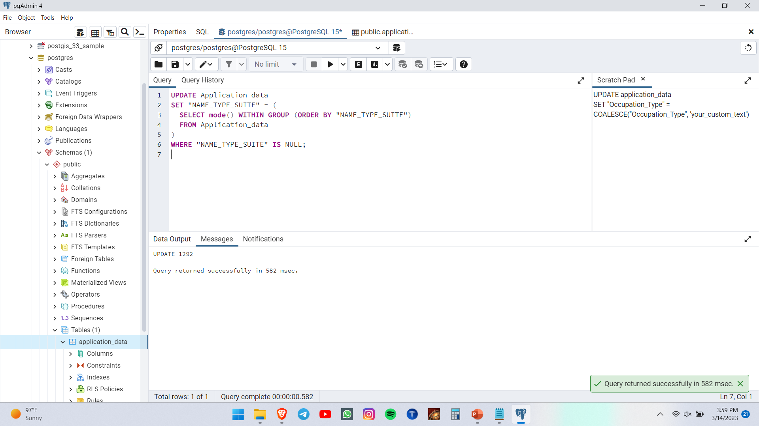
Replacing with median and mode

Slide 13
Clean table link
https://docs.google.com/spreadsheets/d/1Wyxm71LrgVIAz_xYKgYkncCsxommYYdV/edit?usp=sharelink&ouid=107314121677265382892&rtpof=true&sd=true

Slide 14

Target analysis

Slide 15
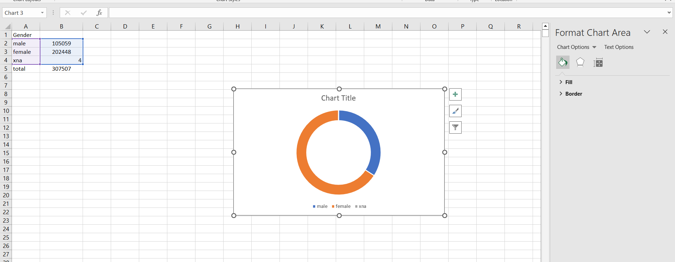
Gender variable

Slide 16
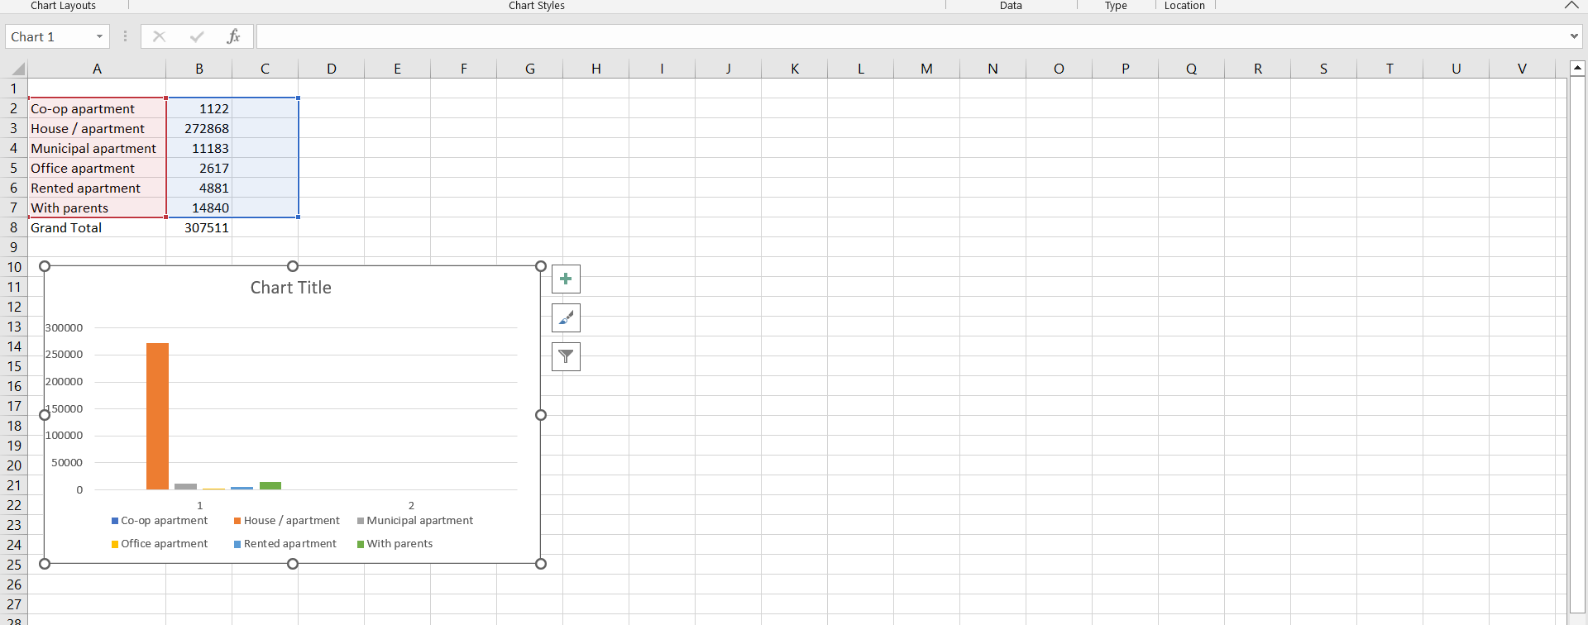
Housing

Slide 17
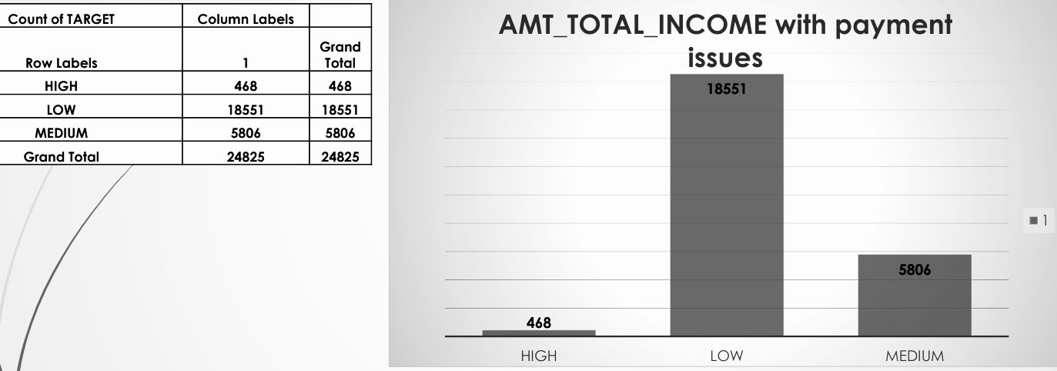
UNIVARIATE ANALYSIS:-AMT_TOTAL INCOME

Slide 18
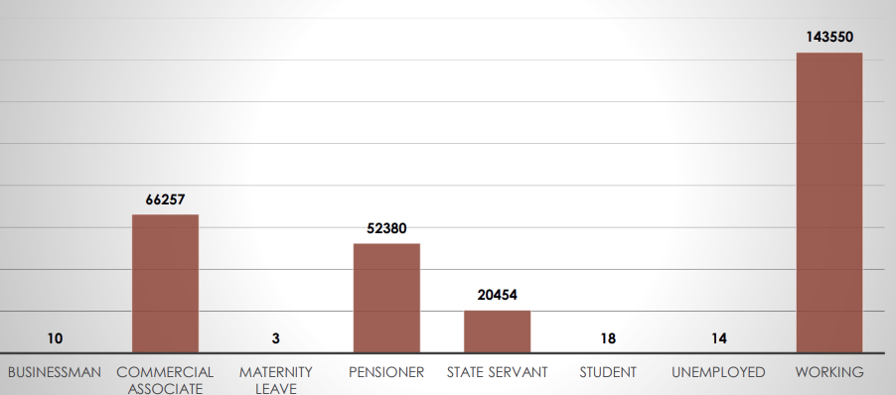
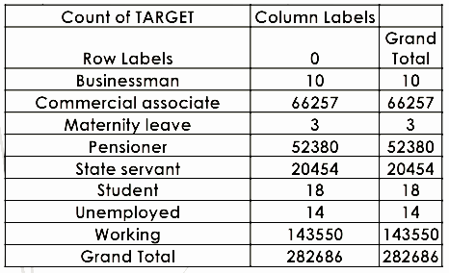
Univariate Analysis NAME_INCOME_TYPE

Slide 19
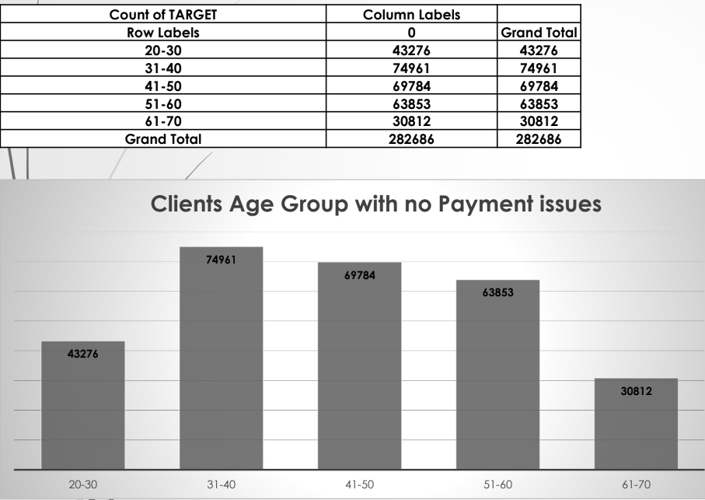
Univariate Analysis Age group

Slide 20
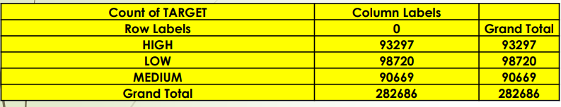
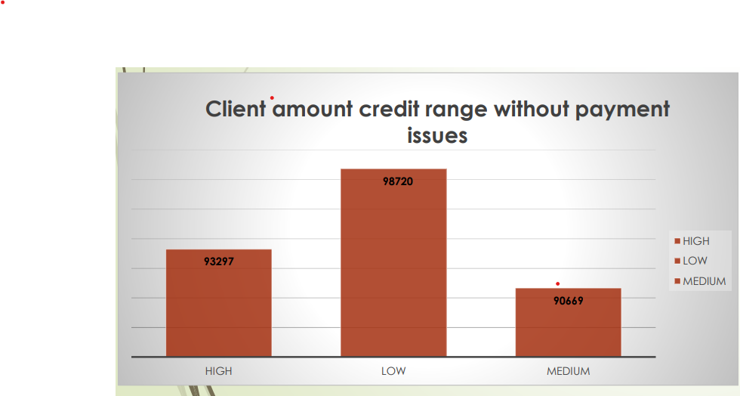
Univariate analysis:-Client amount credit according to range

Slide 21
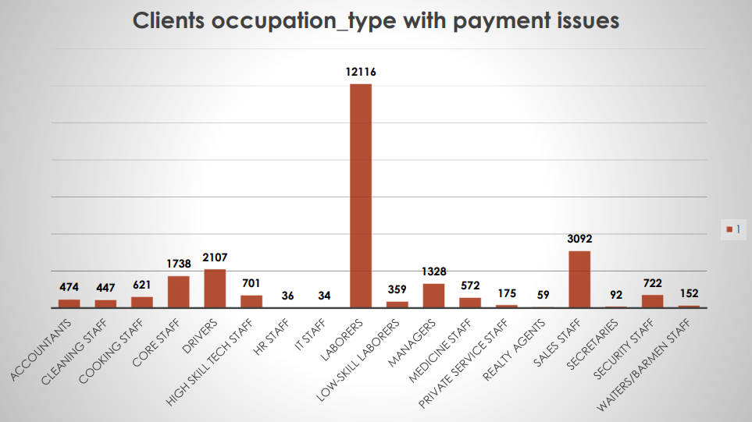
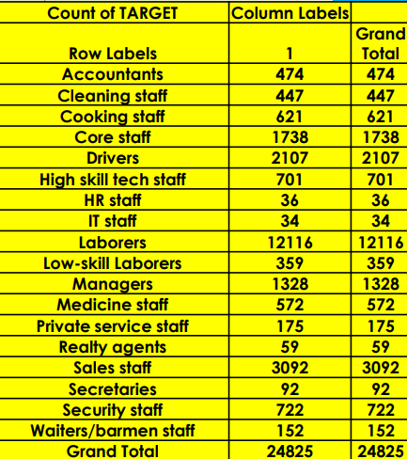
Univariate Analysi:- OCCUPATION_TYPE

Slide 22
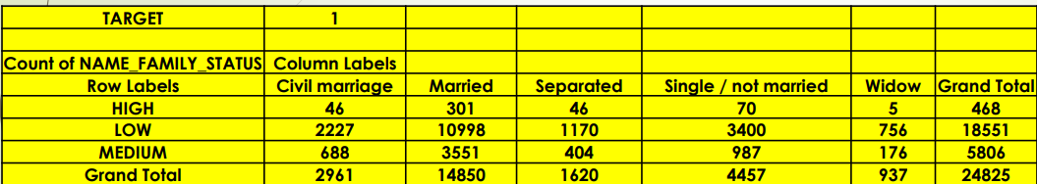
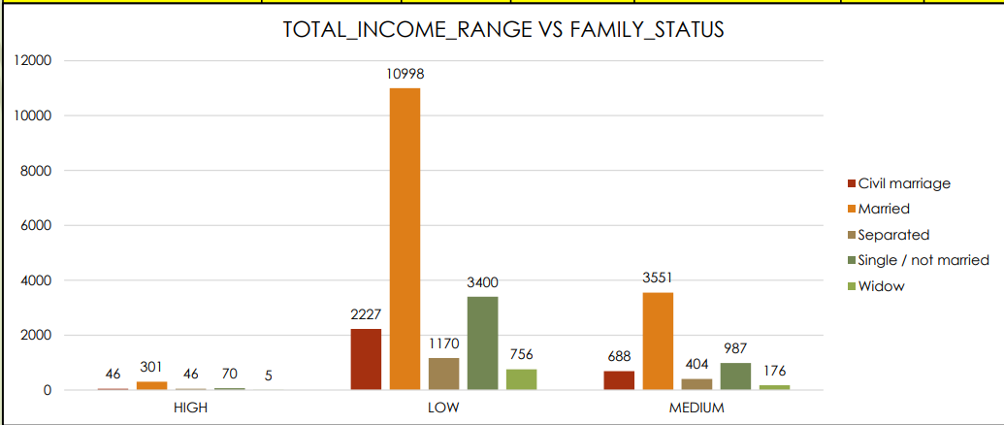
Bivariate Analysis:- Total Income vs Family status

Slide 23
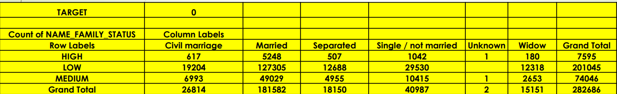
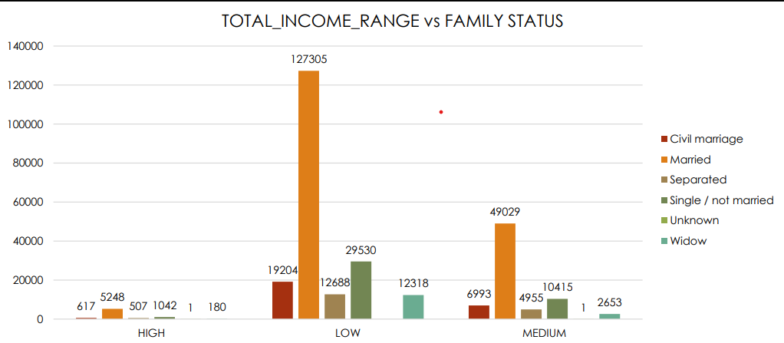
Bivariate Analysis:- Total Income vs Family status

Slide 24
Removing these columns in the dataset (previous_applications)
HOUR_APPR_PROCESS_START • WEEKDAY_APPR_PROCESS_START_PREV • FLAG_LAST_APPL_PER_CONTRACT • NFLAG_LAST_APPL_IN_DAY • SK_ID_CURR • WEEKDAY_APPR_PROCESS_START

Slide 25
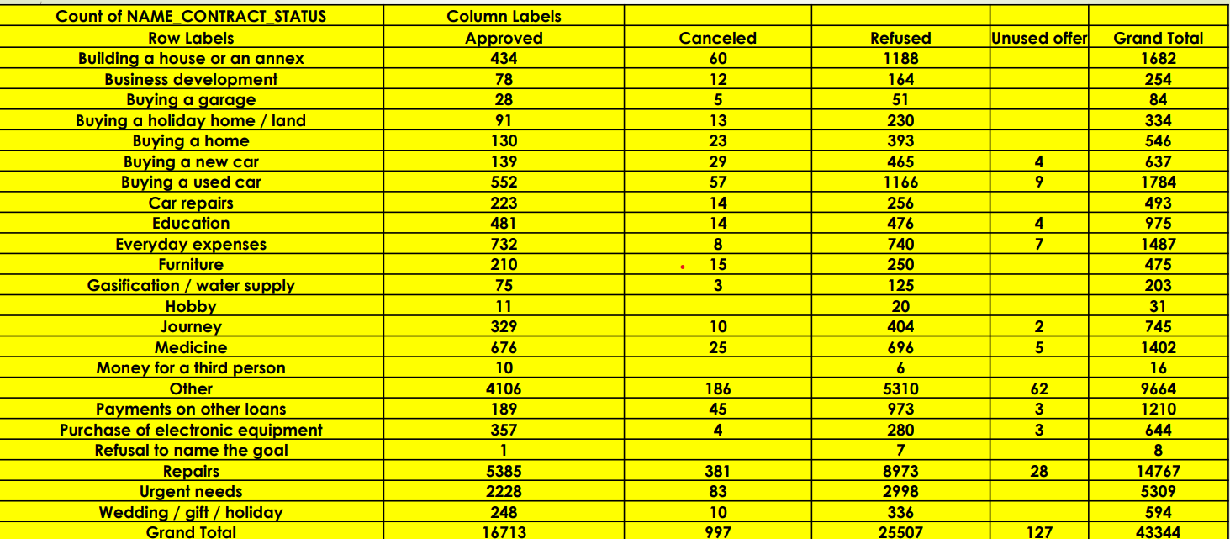
Distribution of Name Contract Status

Slide 26
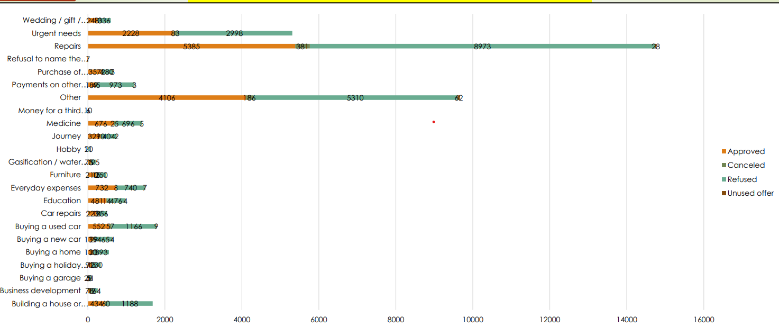
Distribution of Name Contract Status

Slide 27
Conclusions
with Business and Education purposes. The bank should thoroughly check their creditworthiness and financial stability before approving loans for such purposes.
Based on the above conclusions, the bank can make some changes in its lending strategy. For example, it can focus more on lending to clients with a working-class background, higher education status, and lower credit amounts. The bank can also give preference to clients who want to purchase a new home or a new car and have a stable income as State Servants. Additionally, the bank should be more cautious when lending money for repairs and business purposes.
Overall, the analysis provides valuable insights for the bank to make informed decisions and minimize the risk of defaults. However, the bank should also keep in mind that these conclusions are based on historical data and may not necessarily hold true in the future. The bank should continuously monitor its lending portfolio and adjust its strategies accordingly.

